Slide 1
Customer Retention & Churn Risk Analysis For a Retail European Bank
Analysis on account information for 10,000 customers at a European bank, including details on their credit score, balance, products, and whether they have churned.

Slide 2
Business Problems
What attributes are more common among churners than non-churners? Can churn be predicted using the variables in the data?
What do the overall demographics of the bank's customers look like?
Is there a difference between German, French, and Spanish customers in terms of account behavior?
What types of segments exist within the bank's customers?

Slide 3
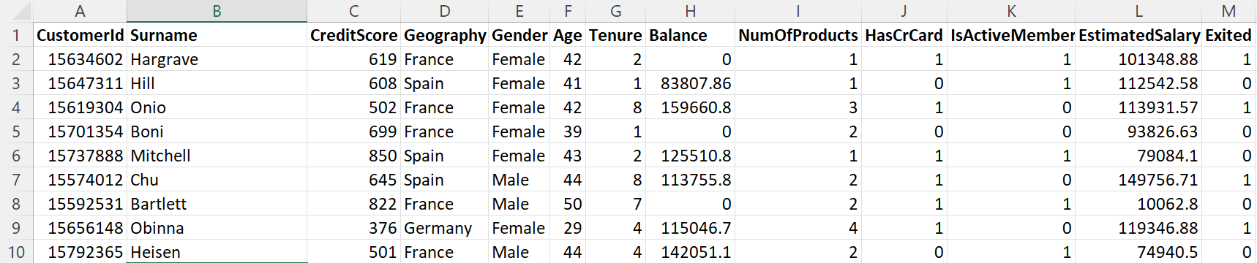
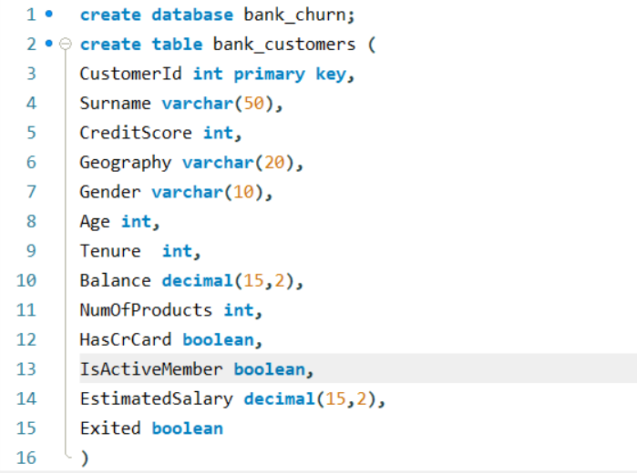
Dataset Overview and Data Preparation
Raw customer data initially explored in Excel
Dataset imported into MySQL for structured analysis
Table schema designed to reflect customer demographics & behavior
Ensured data integrity before performing churn analysis

Slide 4

Overall Customer Demographics Based on Gender
Business Importance:
Balanced gender distribution means:
No over dependence over a single demographic
Opportunity to design gender-specific financial products
Slight male skew may indicate :
Higher adoption of traditional banking products among men
Potential growth opportunity in female-focused financial inclusion
Business Action :
Should launch women centric products
Tailor marketing messages by gender behavior patterns
Insights:
Male Customers: 5457
Female Customers: 4543
Customer base is fairly balanced, with a slight male dominance

Slide 5

Overall Customer Demographics Across Countries
Business Importance:
Indicates market concentration risk
Revenue and churn impact will be the highest in France
Germany and Spain represent growth or diversification markets
Business Action:
Prioritize retention and churn prevention in France
Increase product penetration campaigns in Germany and Spain
Compare best practices across countries
Insights:
France: 5014 customers
Germany: 2509 customers
Spain: 2477 customers
France is primary customer market

Slide 6
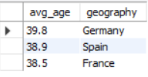
Overall Customer Demographics based on Avg-Age
Business Importance:
Core customer base is mid-career working professionals
These customers typically demand:
  Loans
  Credit Cards
  Investment
  Wealth management
Business Action:
Promote long term financial products
Bundle salary accounts, loans, and investment
Design life-cycle based offerings
Insights:
Germany: 39.8
Spain: 38.9
France: 38.5
Average age is consistent across countries

Slide 7
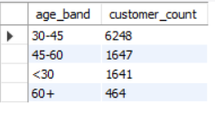
Overall Customer Demographics across different age bands
Business Importance:
Bank heavily depends on prime-earning age customers
Very small senior population – lower pension and retirement product adoption
Younger customers present future lifetime value.
Business Action:
Focus retention efforts on 30-45 group (highest revenue risk )
Upsell investments to 45-60 group
Attract <30 customers via digital-first products
Insights:
30-45: 6248 customers
45-60: 1647 customers
<30: 1641 customers
60+: 464 customers

Slide 8
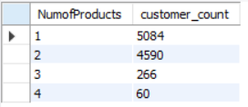
Overall Customer Demographics based on product distribution
Business Importance:
Majority of customers hold only 1-2 products
Very few customers are deeply engaged
Indicates low product penetration
Business Meaning:
Customers exist but relationships are shallow
Business Action:
Strong cross-sell opportunities
Bundle products instead of selling individually
Target single product customers with high balance
Insights:
1 product: 5084 Customers
2 products: 4590 Customers
3 products: 266 Customers
4 products: 60 Customers

Slide 9

Overall Customer Demographics based on Balance
Business Importance:
Indicates overall monetary value of the customer base
Serves as a benchmark for:
  High value customer definition
  Cross sell targeting
  Churn Risk Analysis
Business Action:
Customers above this threshold are premium candidates
Customers far below this may be low- value or high-risk churners

Slide 10

Overall Customer Demographics based on Credit Score
Business Importance :
Indicates moderate credit worthiness
Majority customers are eligible for:
  Credit Cards
  Personal Loans
But not premium unsecured landing at scale
Business Action:
Credit improvement programs
Tiered lending products
Risk-based pricing strategies
Executive Summary: The customer base is dominated by mid-career professionals primarily located in France, with
moderate balances and credit scores. Most customers hold only one or two products, indicating strong cross-sell
potential. These insights help the bank prioritize retention in key markets, design age-specific financial products,
and improve product penetration without aggressive customer acquisition.

Slide 11

Overall Churn Overview
Business Meaning:
Roughly 1 out of 5 customers leaves the bank
This is a material revenue and growth risk, not a minor issue
Business Importance:
A 20% churn rate signals customer dissatisfaction or weak engagement
Even a 1-2% reduction in churn can significantly increase profitability due to :
  Lower acquisition costs
  High lifetime value (LTV)
Churn reduction should be treated as a top strategic KPI, not just an analytics metric

Slide 12

Churn vs Non-Churned
Business Meaning :
The retained base is strong, but the churned group is strong enough to analyze the patterns and intervene
Business Importance :
This validates the need for segmentation-based churn prevention rather than blanket policies
Retention efforts can focus on specific high-risk segments instead of all customers

Slide 13

Overall Churn Overview based on Gender
Business Meaning :
Female customers churn at a significantly higher rate than male customers.
Business Importance :
Indicates possible:
  Product mismatch
  Service experience gaps
  Communication or engagement issues for female customers
Business Actions:
Review:
  Product stability
  Customer Support journeys
  Personalized offers for female segments
Opportunity to design gender-sensitive engagement
strategies

Slide 14

Overall Churn Overview across countries
Business Meaning:
Germany is a main churn hotspot
Nearly 1 in 3 German customer leaves
Business Importance :
Suggests regional operational or competitive issues, such as :
  Stronger competitors
  Poor local service delivery
  Pricing or regulatory challenges
Business Actions:
Conduct region-specific root cause analysis
Localize :
  Pricing
  Offers
  Customer Support
Germany should be prioritized for retention
investment

Slide 15

Overall Churn Overview by Customer Activity
Business Meaning :
Inactive customers churn at almost double the rate of active customers
Engagement is a leading indicator of churn
Business Importance :
Confirms that engagement drives retention
Activity status can be used as an early warning signal
Business Actions:
Trigger:
  Re-engagement campaigns
  Nudges, alerts, offers
Use inactivity as a predictive churn flag, not a
reactive metric
Executive summary: Our analysis reveals a 20.37% churn rate, primarily driven by inactive customers, female segments, and
the German market – highlighting clear, actionable opportunities for targeted retention strategies.

Slide 16

Geography-Based Behavior Analysis
Business Meaning:
Germany holds almost 2 times the average balance of France and Spain
This means:
  Higher revenue per customer
  Higher revenue at risk if churn happens
German customers represent the bank’s highest monetary value segment, making churn in this region disproportionately expensive
Business Actions:
Prioritize retention-first strategy for German customers
Assign:
  Dedicated relationship managers
  Premium loyalty benefits

Slide 17

Credit Score Comparison-Risk Quality Signal
Business Importance:
Credit scores are fairly similar across countries
This tells us:
  Churn differences are not driven by credit quality
  Behavior and engagement matter more than financial risk
Key Insight :
Churn variation across countries is behavior-driven not credit-driven
Business Actions:
Do not over-tighten credit policies country wise
Focus on:
  Engagement programs
  Product usage
  Activity simulation

Slide 18

Product Holding Patterns – Cross Sell Opportunity
Distribution Insight:
Across all countries :
  Majority customers hold only 1 product
  Very few customers have 3-4 products
Business Importance:
Low product penetration = low switching cost
Customers with 1 product can switch easily
Key Insight:
Despite high balances, customers are under-penetrated on products – creating a churn vulnerability
Business Actions:
Launch country specific cross-sell campaigns
  Germany – wealth & investment products
  France – bundled banking packages
  Spain – entry level add-on products
KPI to track: Products per customer

Slide 19

Activity Rate per Geography – Engagement Health
Business Importance :
Germany:
  Highest Balance
  Lowest Activity
This is a dangerous combination
Key Insight :
German customers are high-value but disengaged – the most critical churn risk group
Business Actions:
Immediate engagement push for Germany:
  Personalized nudges
  App usage incentives
  Proactive relationship outreach
Treat inactivity as a leading churn indicator

Slide 20
Combined Country Risk Profiles
Germany – High Value High Risk
Highest Balance
Lowest Activity
High Churn Impact
Strategy: Retain at all costs
France – Stable but Under-Leveraged
Largest Customer Base
Moderate balance & activity
Strategy: Scale cross-sell and &
loyalty programs
Spain – Engaged but Low Value
Highest Activity
Lower Balance
Strategy: Upsell Value, not retention
heavy spending
Executive Summary: Customer behavior varies significantly by geography. Germany represents the bank’s highest revenue
        concentration but shows early churn warning signs due to low engagement. France offers scale and
        cross-sell potential, while Spain shows strong engagement but lower monetary value. Country specific
        strategies are essential to maximize revenue and retention.

Slide 21

Customer Segmentation & Action Strategy
Business Importance:
1499 customers are the most valuable and loyal customers with high balance, active engagement and not yet churned
They contribute disproportionately to revenue
Losing even a small % hurts profitability badly
Business Action :
Relationship management
Personalized offer
Priority support
Wealth/ investment products

Slide 22

High Balance & Inactive Churn Risks
Business Importance:
1797 customers posses high balance but no active engagement, adding to churn warning signal
This is revenue at immediate risk
Most dangerous churn segment
Business Actions:
Immediate intervention
Re-engagement campaigns
Relationship manager calls
Fee waivers / loyalty benefits

Slide 23

Low Balance – High Churn Customers
Business Importance:
4081 customers mean a large customer base but with low individual balance and indicating moderate churn rate
This is a volume problem, not revenue problem
Losing many customers impacts:
  Brand perception
  Market share
  Acquisition cost

Slide 24

Multi Product Retained Customers
Business Importance:
The customer base for multi products is very small
High product count should reduce churn, but here it isn’t possibly:
  Forced cross-selling
  Wrong product fit
  Poor onboarding
Signals product strategy or experience issue
Business Action:
Check product usability
Review cross-sell timing
Improve onboarding & education
Fix product mismatch, not push more products

Slide 25
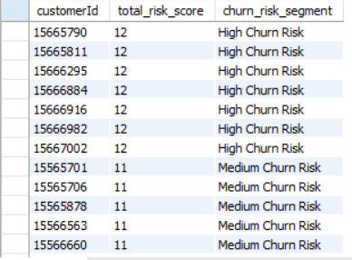
Churn Risk Scoring – Predictive Analysis
Business Importance:
Each customer is assigned a risk score based on 5 critical dimensions such as age, balance, credit score, activity, products
Each factor is weighted and the scores are summed to form a total risk score
This model helps in:
  Identifies churn before it happens
  Allows proactive retention
  Retention is focused on high – risk customers
  Avoids incentive loss on low value customers
  Prevents high value customer loss
  Reduce surprise churn risks
  Can be directly handed to CRM / marketing teams
Business Actions:
Score > 12 : Fee Waivers, personalized offers
Score 8-11: Targeted campaigns, product education,
loyalty rewards
Score < 8 : Upsell Opportunities, no aggressive retention
spend
Executive Summary: This churn risk scoring model allows the bank to proactively identify high-risk customers and take targeted
retention actions before revenue loss occurs

Slide 26
Final Actions for Next Quarter
Retention first strategy for Germn Customers
Immediate re-engagement for inactive high-balance customers
Cross-sell push for single product customers
Gender-focused experience audit
Deploy churn risk scoring in CRM

Slide 27
Final Business Questions Answered
What attributes are more common among churners than non-churners?
Age, low product count, inactivity, geography, balance
Can churn be predicted using the variables?
Yes — via SQL risk scoring and ML-ready feature sets
What do the overall demographics look like?
Age, gender, geography, financial distribution
Is there a difference between German, French, and Spanish customers?
Yes — churn, balance, and engagement vary significantly
What types of customer segments exist?
Value-based, lifecycle-based, behavior-based segments

Slide 28
Thank You

